Slide 1
COMP5703
KINDER FOOD FINDER SYSTEM
Kinder Food Finder Group 2

Slide 2
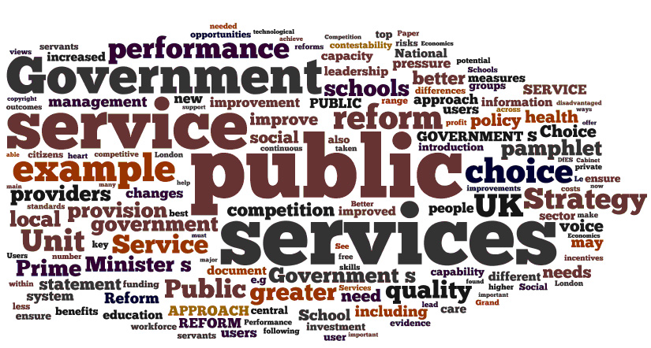
TABLE OF CONTENT
1. | PROJECT BACKGROUND
2. | MOBILE APPLICATION
3. | WEB-PAGE SERVER
4. | LIMITATION & DISCUSSION
5. | CONCLUSION/ NEXT STEPS
6. | Appendix

Slide 3
TABLE OF CONTENT
1. | PROJECT BACKGROUND
2. | MOBILE APPLICATION
3. | WEB-PAGE SERVER
4. | LIMITATION & DISCUSSION
5. | CONCLUSION/ NEXT STEPS
6. | Appendix

Slide 4
1
PROJECT BACKGROUND
Introduction to the project (1/2)
Animal welfare refers to how animals or livestock is coping with the conditions in which they live.
Farmstead and Brand can adopt this movement and raise animal in a moral way.
More and more people wants support for the animal welfare practice.
Standards by animal welfare organizations help consumers to identify “animal-friendly” products.

Slide 5
1
PROJECT BACKGROUND
Introduction to the project (2/2)
Gap exists between consumers’ attitude and behavior due to:
Cheaper, tastier products;
Time consuming, complex information searching process.
Lack of connection between organizations and individual
Client’s objective: Collecting data about consumers’ behaviour to analyse and identify factors that impact purchasing decision toward animal-welfare.

Slide 6
1
PROJECT BACKGROUND
Kinder Food Finder project
SOLUTION
Kinder Food Finder system
This project adopts the sourcing method.
Main objective is developing an IT system:
Let users search for animal-welfare information of products;
Record users’ searching history.
The way information is presented could impact people’s behavior
(Levine, Chan, Satterfield, 2015)
Collect users’ data
Let users access animal-welfare information

Slide 7
1
PROJECT BACKGROUND
Requirements for the system
MOBILE APPLICATION
Search/ browse function that displays animal-welfare rating of different brands;
Locate and Report function enables users inform others and to find where to buy a brand;
Collect statistical data from users (i.e. How many times a brand is searched)
SERVER
Database management functions: insert, query, delete, update;
Able to communicate with the mobile app (Receive and send data);
Summarize and display statistical data.

Slide 8
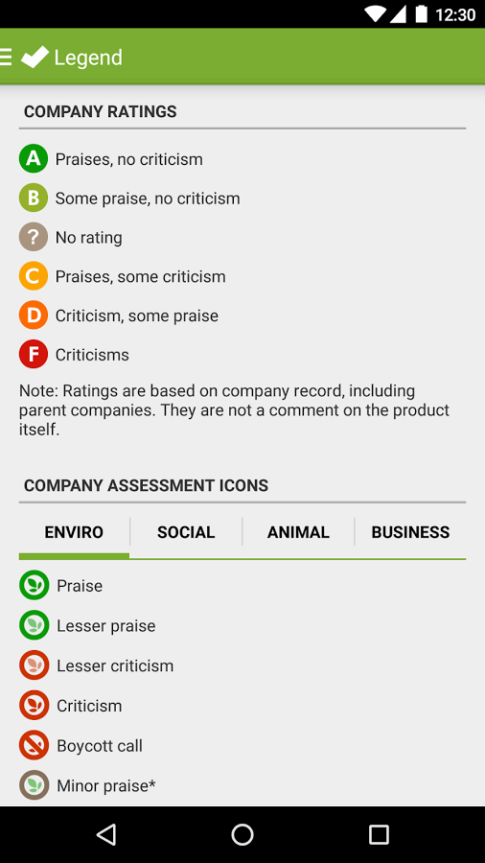
1
PROJECT BACKGROUND
Related works (1/2) – Shop ethical!
Shop ethical!
Mobile application
Provide users with ethical information of the several companies (Not ethics of the product)
Support users making purchasing decision.
Cover multiple product categories: Food & Drink, Baby, Clothing, Pet, Retail, Toys, etc.
Figure 1. Shop ethical! app

Slide 9
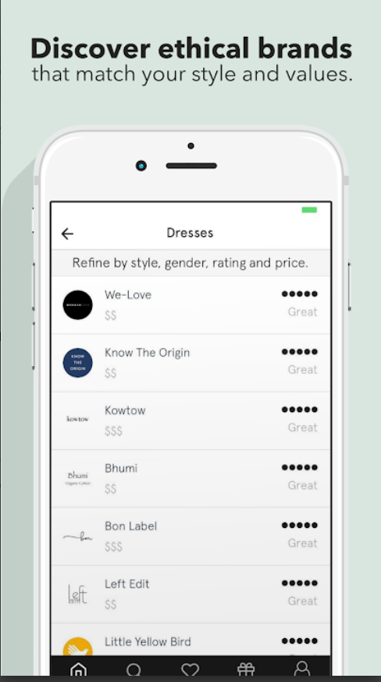
1
PROJECT BACKGROUND
Related works (2/2) – Shop ethical!
Good on you
Mobile application
Users can access ethical rating of fashion brands.
Rating is determined by how the brand involves in: pollution, waste, human and animal welfare.
Figure 2. Good on You app

Slide 10
TABLE OF CONTENT
1. | PROJECT BACKGROUND
2. | MOBILE APPLICATION
3. | WEB-PAGE SERVER
4. | LIMITATION & DISCUSSION
5. | CONCLUSION/ NEXT STEPS
6. | Appendix

Slide 11
2
MOBILE APPLICATION
Implementation
Languages: JAVA
Software: Android Studio
Third Party Libraries and Tools
Facebook Login— User login;
Google play services: Maps—location implementation;
Volley— Internet implementation;
Picasso—Image load and cache;
Gson— JSON file parse;

Slide 12
2
MOBILE APPLICATION
Main Features
Search for rating by brand or accreditation
Browse a rating by category, accreditation, and rating
Report a Store Feature
Location Feature
Data Interaction Feature

Slide 13
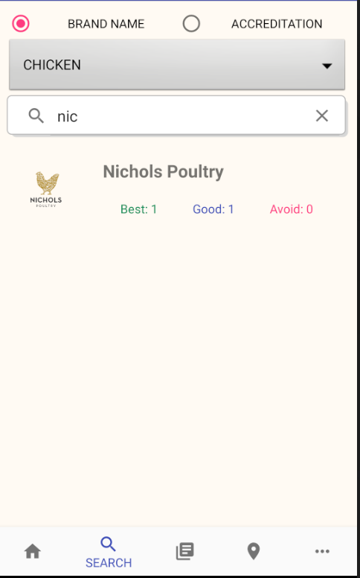
2
MOBILE APPLICATION
Main Features — Search Feature by Brand Name
1
DESCRIPTION
Users can click on a radio button to select one of the searching filters like BRAND NAME.
Users can choose a product category from the drop-down list (such as, eggs, chicken or pork).
Users can input text on the search box to conduct searching by brand name. For instance, users input “nic” text in the search view.
The result will be displayed in the recycler view. When users click on one item of the result, the application will direct user to the Detail page.
2
3
4

Slide 14
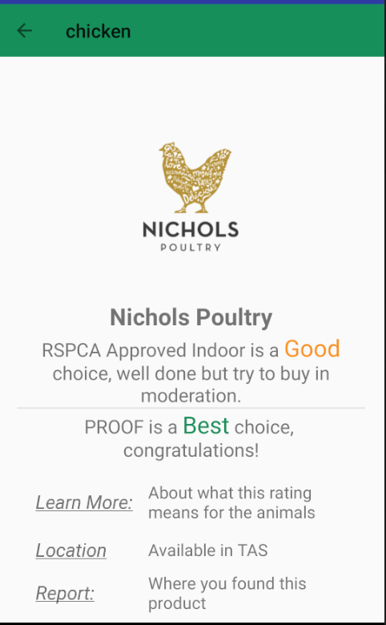
2
MOBILE APPLICATION
Main Features — Search Feature by Brand Name
DESCRIPTION
In the Detail page, it will show the information about the brand, including brand name, accreditation, rating, location and brand image.
One brand may have multiple ratings according to different accreditations.
1

Slide 15
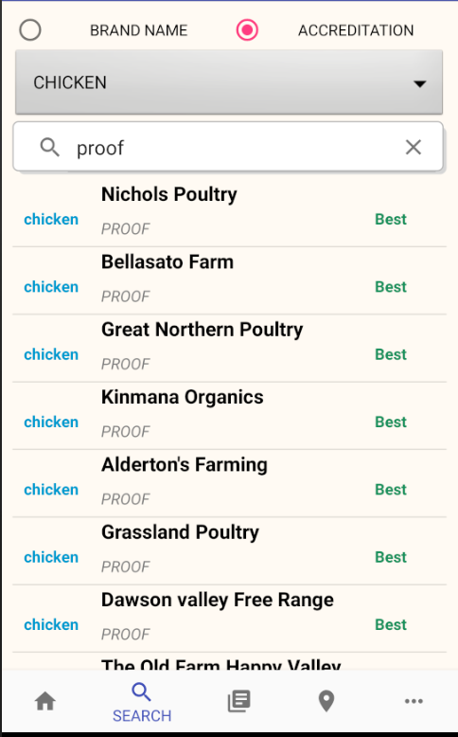
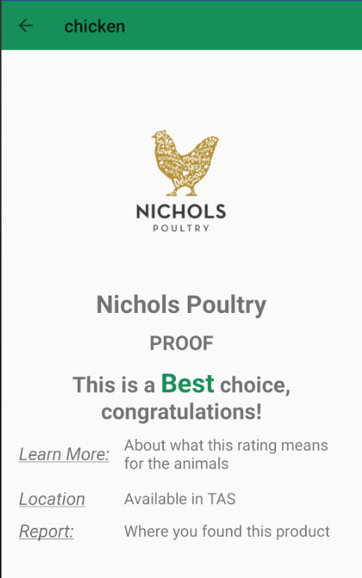
2
MOBILE APPLICATION
Main Features — Search Feature by Accreditation
1
DESCRIPTION
Users can click on a radio button to select one of the searching filters like ACCREDITATION.
Users can choose a product category from the drop-down list like CHICKEN.
Users can input text on the search box to conduct searching by brand name. For instance, when users input “proof” text in the search view.
The result will be displayed in the recycler view. When users can click on one item of the result, the application will direct user to the Detail page.
2
3
4
3
5

Slide 16
2
MOBILE APPLICATION
Main Features — Search Feature by Accreditation
DESCRIPTION
In the Detail page, it will show the information about the brand, including brand name, accreditation, rating, location and brand image.
Only display One Rating according to the searching accreditation.
1

Slide 17
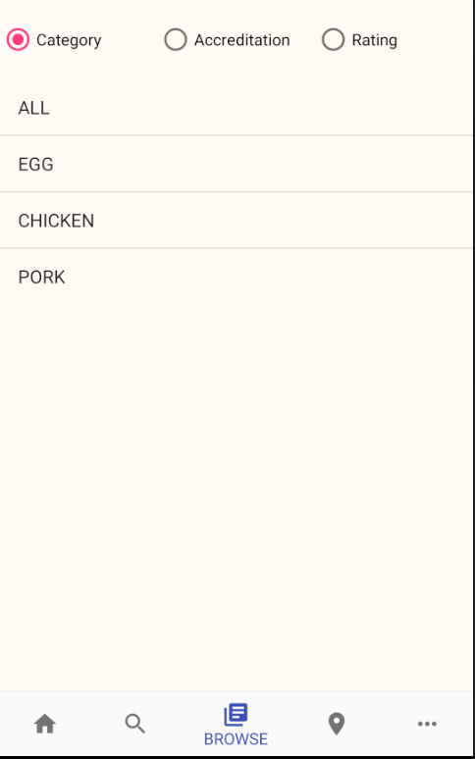
2
MOBILE APPLICATION
Main Feature — Browse Feature
DESCRIPTION
Users can click on a radio button to select one of the browse filters, for instance, Rating, Accreditation or Category.
The result will display in the list view based on the browse filters. Users can choose a Classification like “EGG.”
1
2

Slide 18
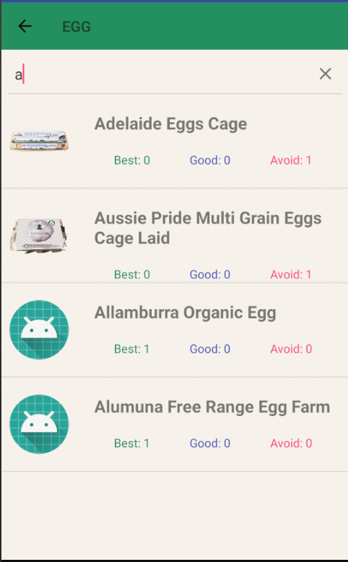
2
MOBILE APPLICATION
Main Feature — Browse Feature
DESCRIPTION
Users can input text on the search box to conduct searching by brand name. For instance, users input “a” text in the search view.
The result will be displayed in the recycler view.
Users can click on one item of the result to view the detail information, the application will direct user to the Detail page.
1
2

Slide 19
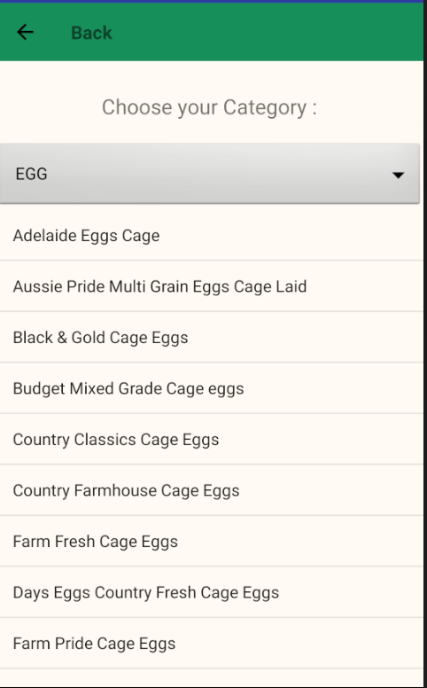
2
MOBILE APPLICATION
Main Feature — Report Feature
DESCRIPTION
Users should choose a product category from the drop-down list, like EGG, CHIKCKEN or PORK.
Users can click on one brand name in the list view. For example, users click on “Country Farmhouse Cage Eggs”, the application will direct users to the Report Page.
1
2

Slide 20
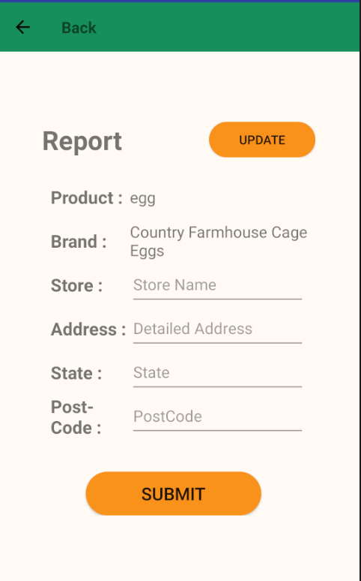
2
MOBILE APPLICATION
Main Feature — Report Feature
DESCRIPTION
In the Report Page, the product category and brand name have already completed by users selection. Users need to fill up the store information, including Store Name, Address, State, and Postcode.
User can click on the “UPDATE” button to ensure the application has the newest data.
Users can click on the “SUBMIT” button when they finish to fill up all data, then the application will send the stored data to the server.
2
1
3

Slide 21
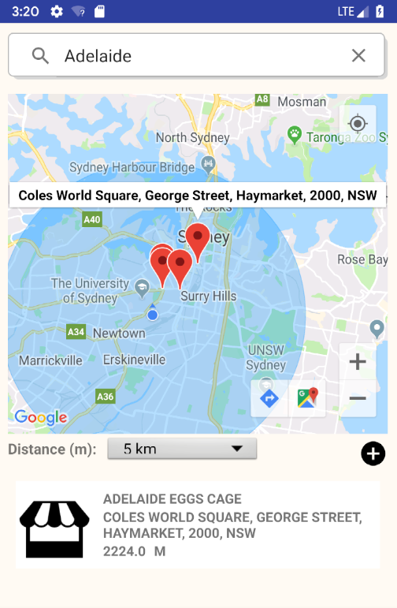
2
MOBILE APPLICATION
Main Feature — Locate Feature
DESCRIPTION
Users can search for a brand name to find a store location that has this brand. For example, users input “Adelaide” on the search view.
Users also can select a searching area such as 1km, 5km, 10km or 20km.
The result will be displayed on the map, users can click the “red mark” to view the location.
The distance between the store and the user’s current location will be shown in the list view.
Users can click the “+” button to report a store where they found this brand. The application will direct users to the report page.
1
3
2
5
4

Slide 22

2
MOBILE APPLICATION
Main Feature — Data Interaction
Data Connection
Application
Server
Login and register request;
Check database request;
Send statistics request;

Slide 23
TABLE OF CONTENT
1. | PROJECT BACKGROUND
2. | MOBILE APPLICATION
3. | WEB-PAGE SERVER
4. | LIMITATION & DISCUSSION
5. | CONCLUSION/ NEXT STEPS
6. | Appendix

Slide 24
3
WEB-PAGE SERVER
Implementation
Languages: Node JS & Express
Software: WebStorm or IntelliJ
Database: MongoDB

Slide 25
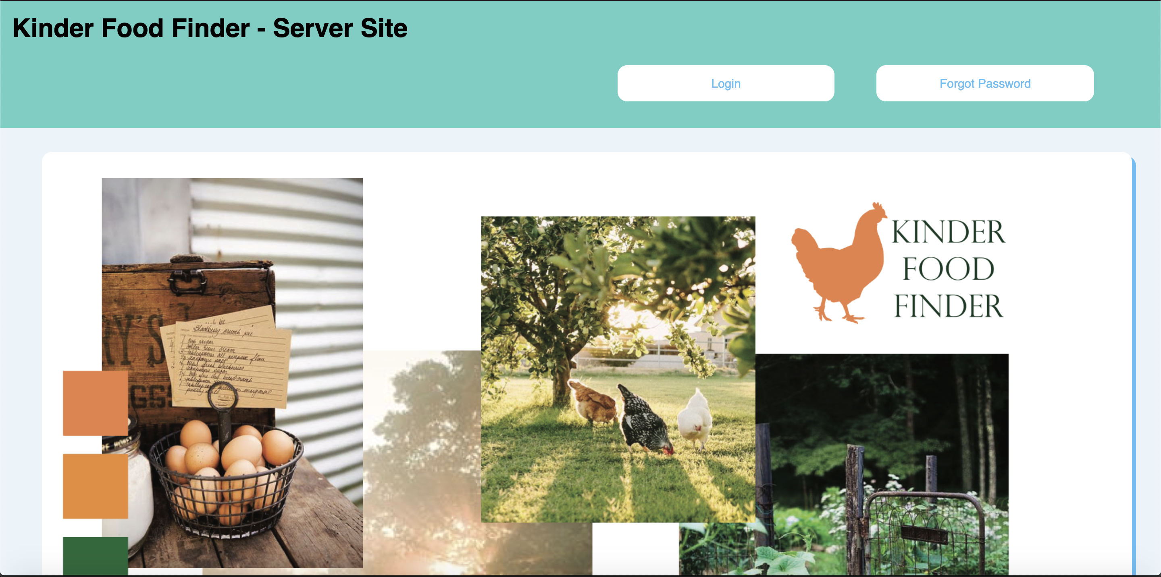
3
WEB-PAGE SERVER
Login Page

Slide 26
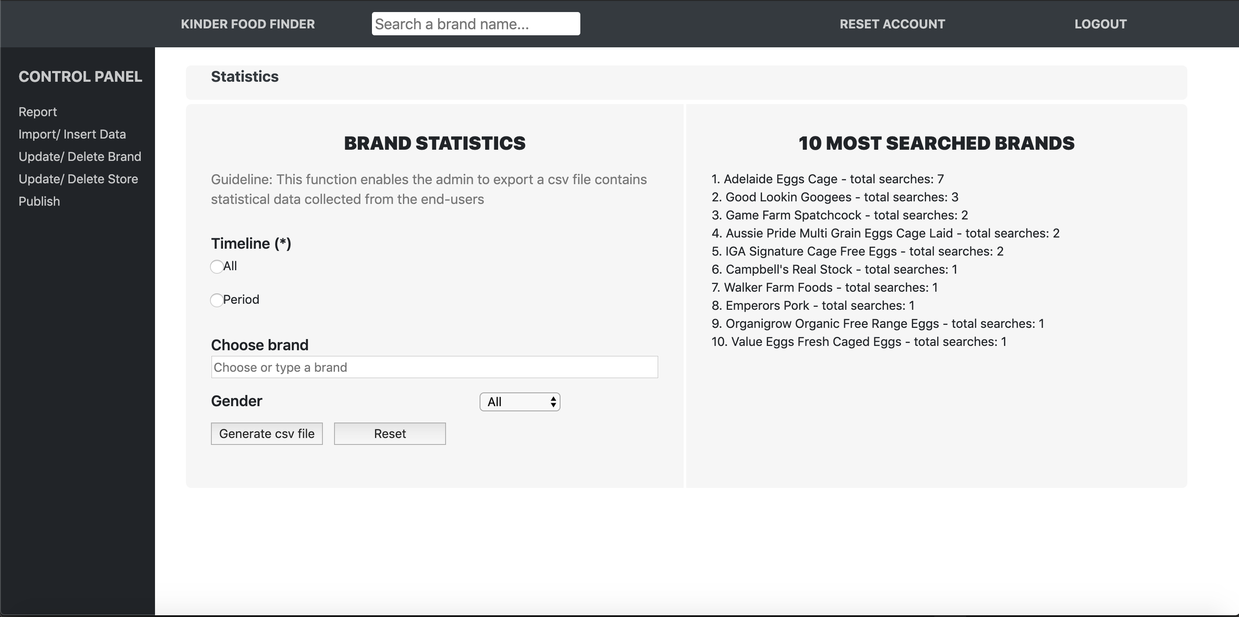
3
WEB-PAGE SERVER
Console Page

Slide 27
3
WEB-PAGE SERVER
5 Main Features
Statistic
Report
Import & Insert Data
Update & Delete Brand/Store
Publish

Slide 28
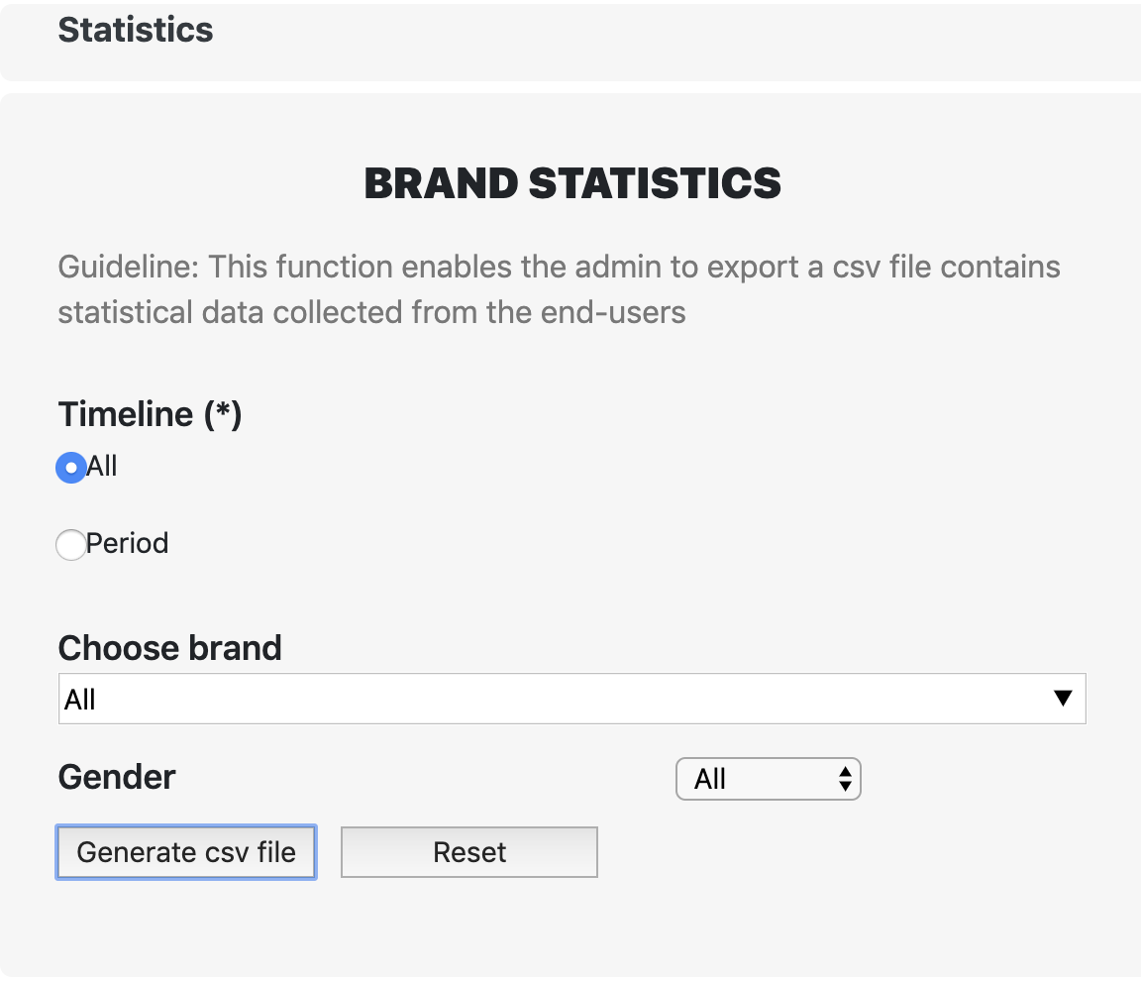
3
WEB-PAGE SERVER
Main Feature – Statistic (1/2)
DESCRIPTION
Admin can select the timeline of brand statistics for csv file generation, and the timeline can be all or a period that has start date and end date.
Admin can choose the statistics of all brands or a certain brand.
The statistics can also be filtered with the gender of app users who produced them.
The “Generate csv file” button is clicked to download csv file of statistics with the conditions chosen above.
The “Reset” button is clicked to reset the filters above to be default.
1
2
3
4
5

Slide 29
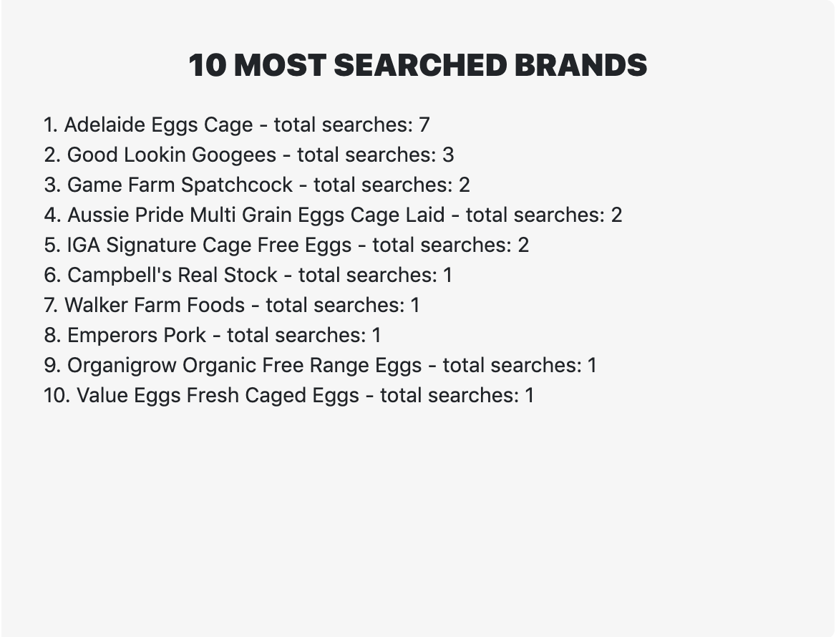
3
WEB-PAGE SERVER
Main Feature – Statistic (2/2)
DESCRIPTION
This is to show the name of brand.
This is to show the total number of searches by app users on this brand.
1
2

Slide 30
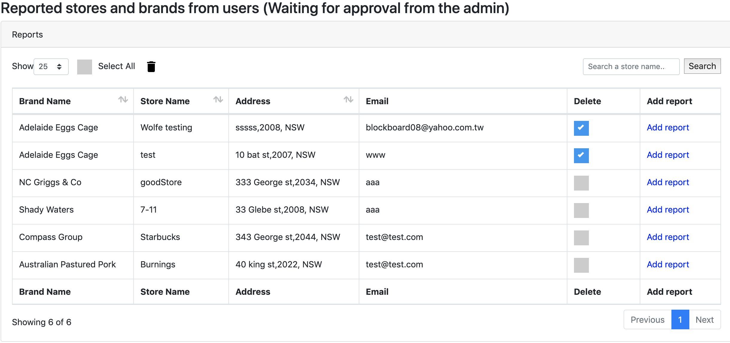
3
WEB-PAGE SERVER
Main Feature – Report (1/3)
2
1
3

Slide 31
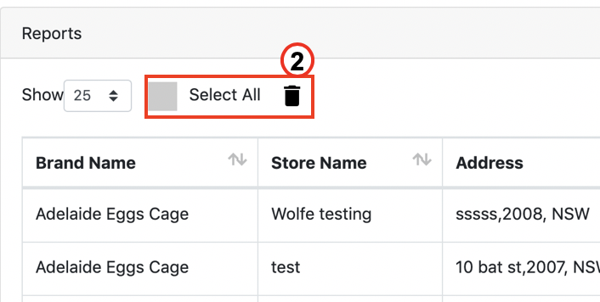
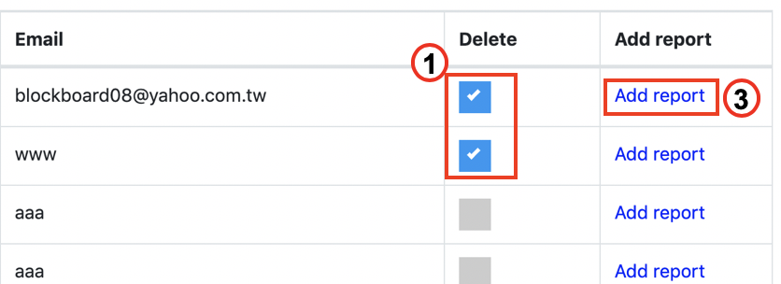
3
WEB-PAGE SERVER
Main Feature – Report (2/3)
DESCRIPTION
Admin can select single report to be deleted.
Or delete all of the reports once by ”Select All”.
The reported store can be added into database after approval by clicking on “Add report”.

Slide 32
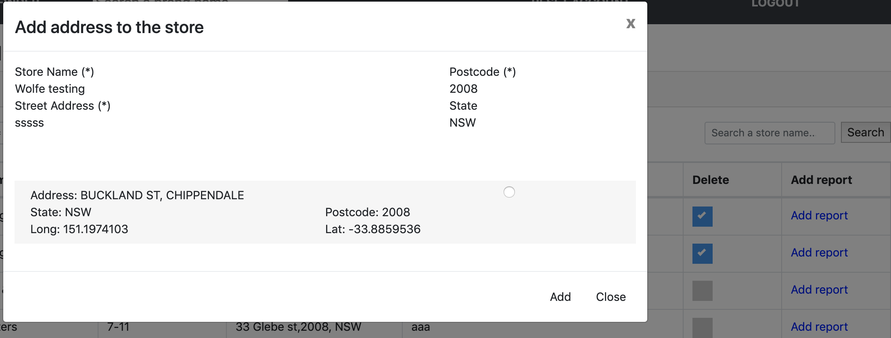
3
WEB-PAGE SERVER
Main Feature – Report (3/3)
1
2
DESCRIPTION
Some optimized addresses will be given based on the reported address of store.
The “Add” button is clicked to store the reports into database with the address.

Slide 33
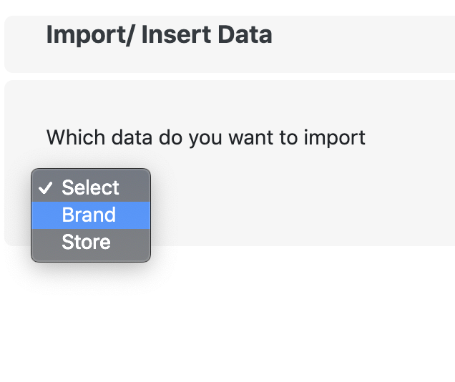
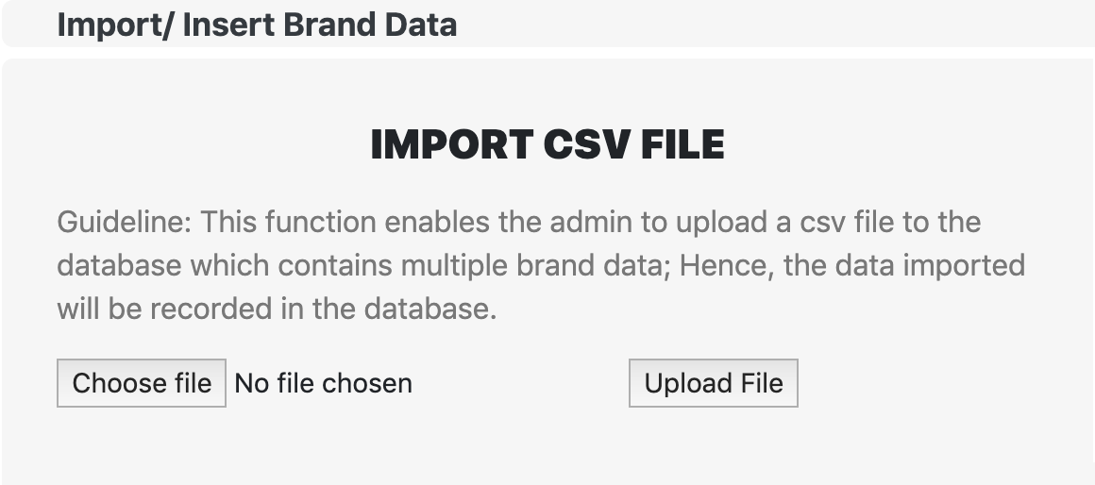
3
WEB-PAGE SERVER
Main Feature – Import & Insert Data (1/2)
DESCRIPTION
Admin can select which kind of data that will be imported – “Brand or Store”.
Admin can choose the csv file on own computer while importing csv file.
The “Upload File” button is clicked to upload the csv file and store every row of data into database.
1
3
2

Slide 34
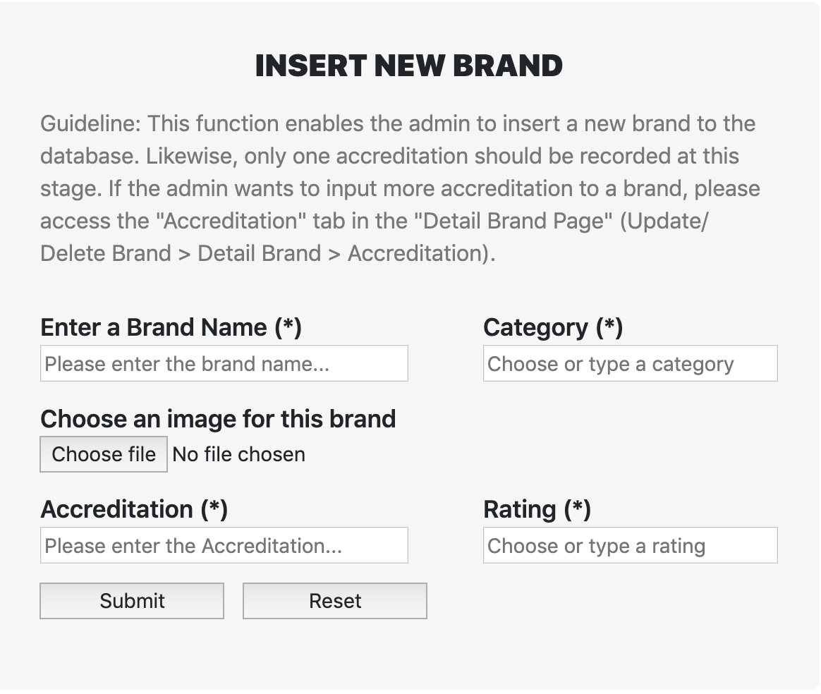
3
WEB-PAGE SERVER
Main Feature – Import & Insert Data (2/2)
DESCRIPTION
Admin can manually insert a brand into database by providing brand name, category, image (optional), accreditation, and rating.
The ”Submit” button is clicked to submit the brand created manually by Admin and store it into database.
The “Reset” button is clicked to reset all the values that have been given in the text bar.
1
2
3

Slide 35
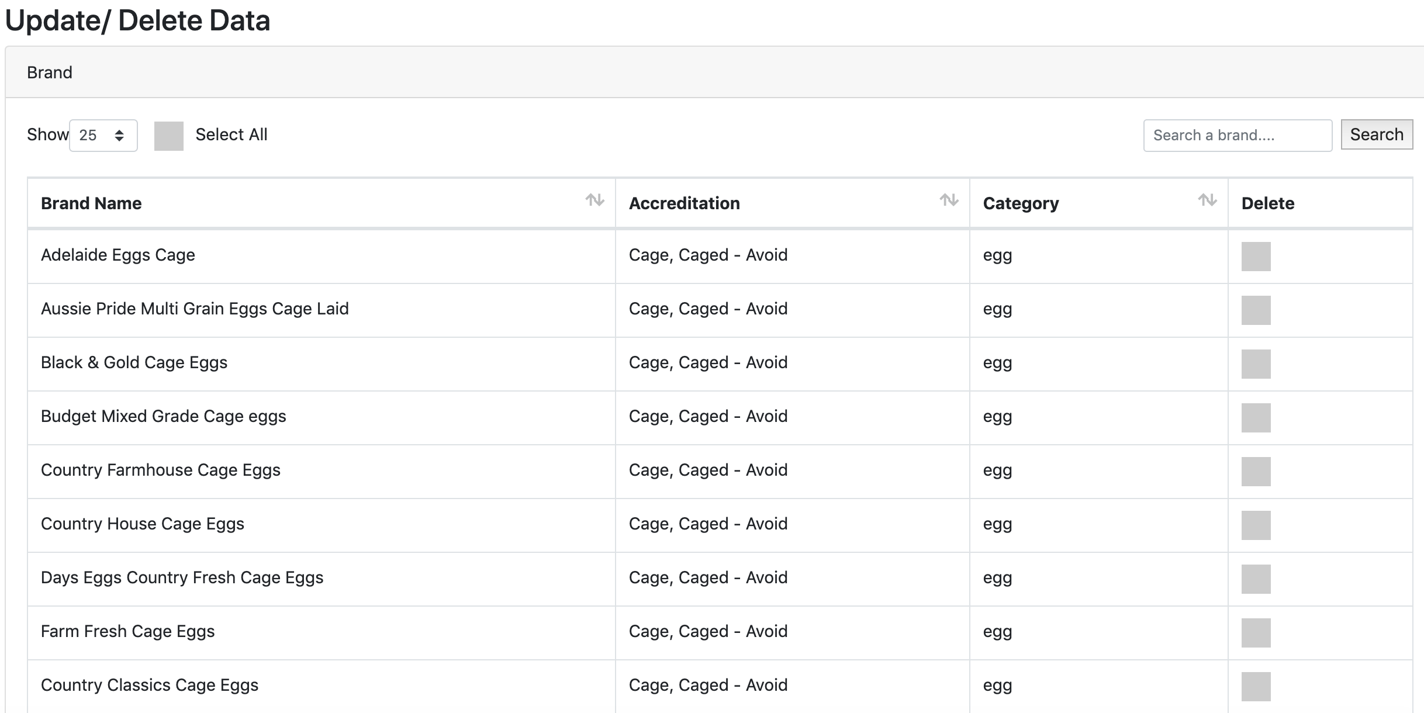
3
WEB-PAGE SERVER
Main Feature – Update & Delete Brand/Store (1/6)
clicked

Slide 36
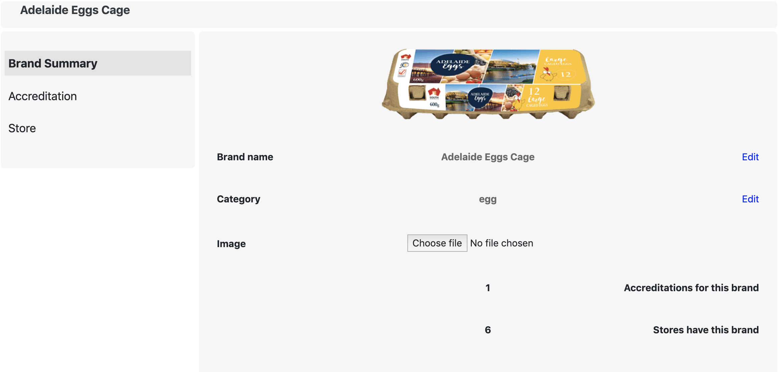
3
WEB-PAGE SERVER
Main Feature – Update & Delete Brand/Store (2/6)
1
2
DESCRIPTION
Admin can edit the brand name and category.
Admin can add image to the brand or replace the original one.

Slide 37
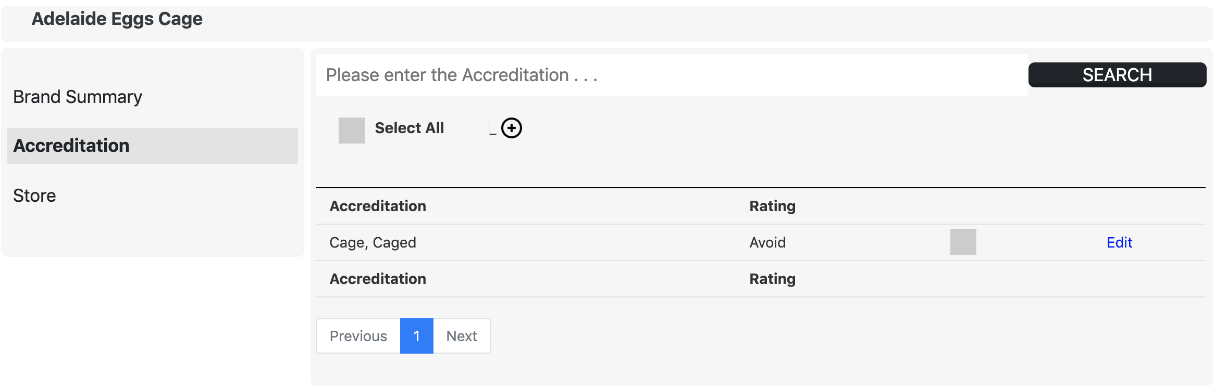
3
WEB-PAGE SERVER
Main Feature – Update & Delete Brand/Store (3/6)
1
2
DESCRIPTION
Admin can add more accreditations into this brand.
The “Edit” button is clicked to edit the accreditation.

Slide 38
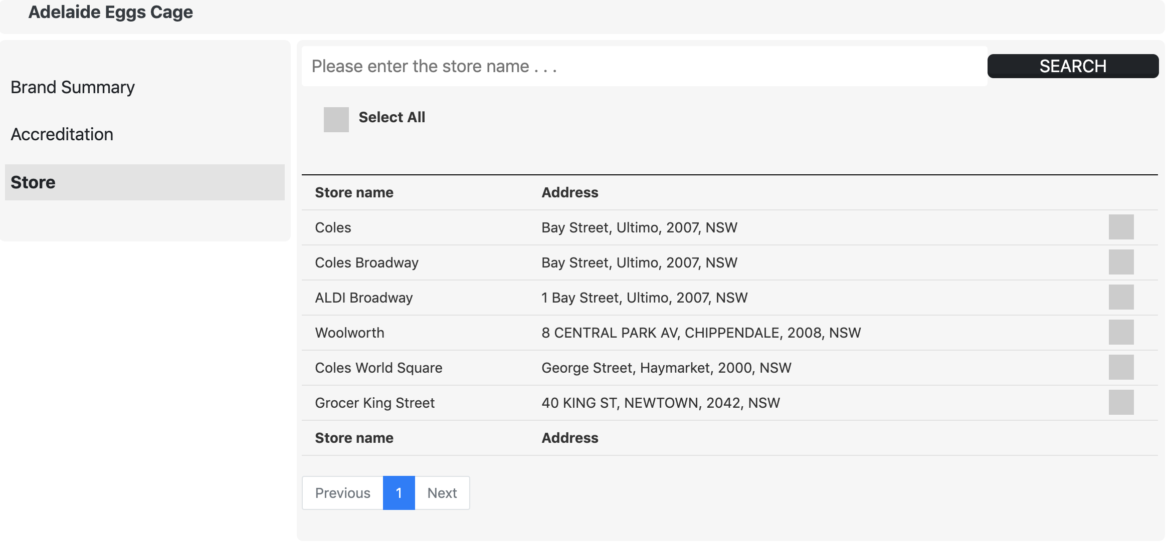
3
WEB-PAGE SERVER
Main Feature – Update & Delete Brand/Store (4/6)

Slide 39
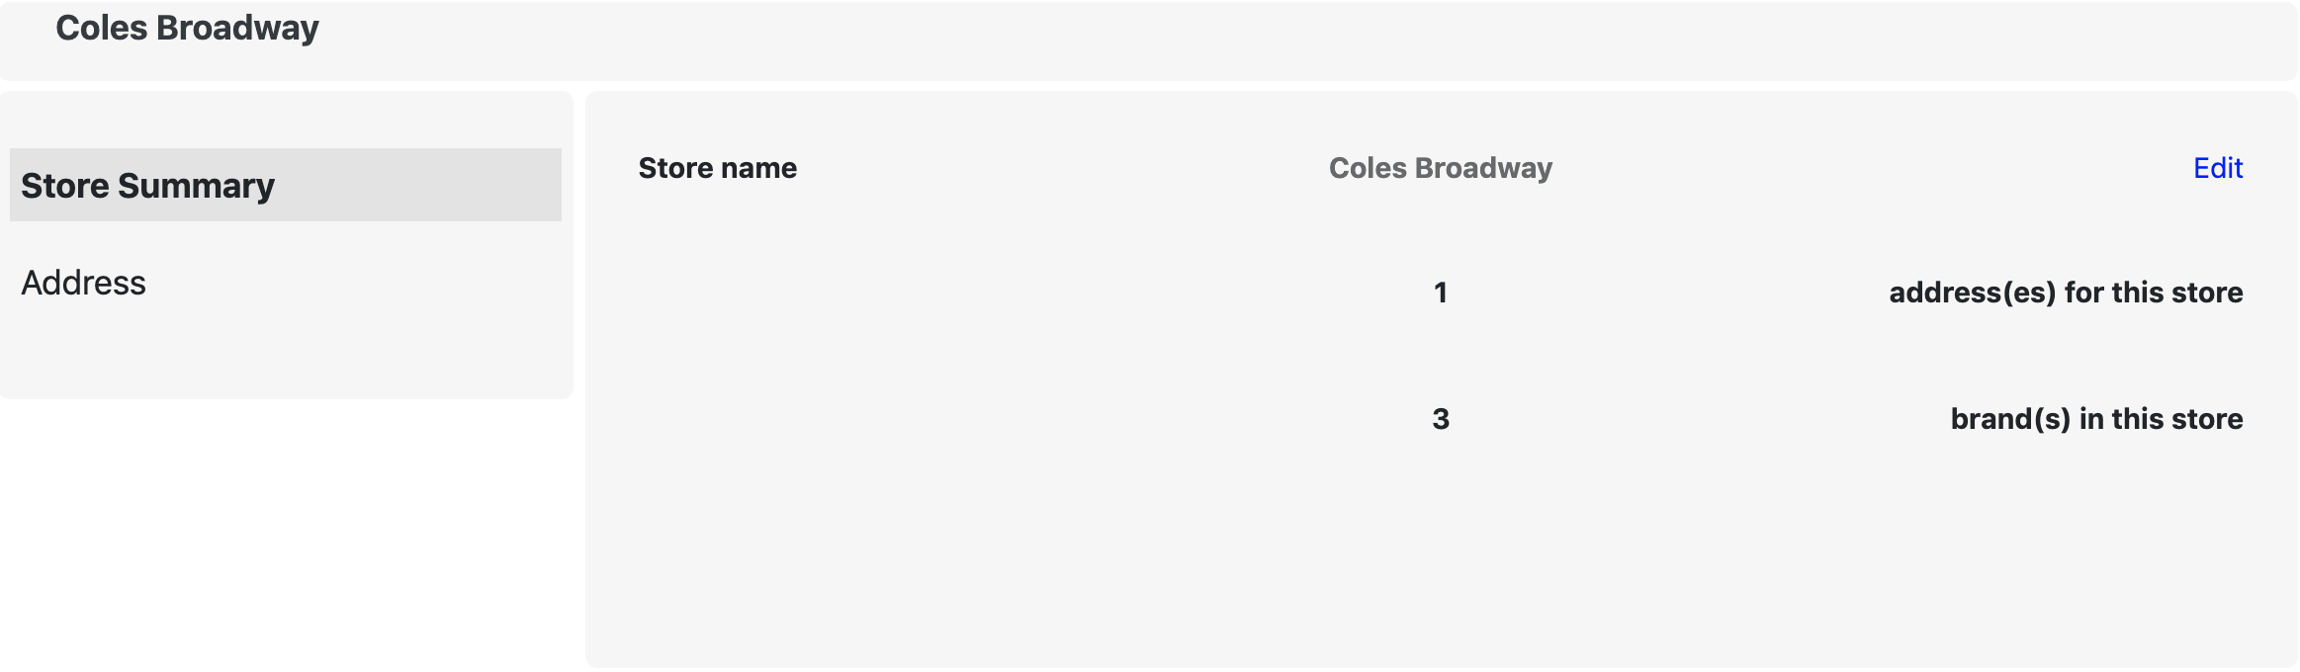
3
WEB-PAGE SERVER
Main Feature – Update & Delete Brand/Store (5/6)
1
DESCRIPTION
Admin can edit the store name again.

Slide 40
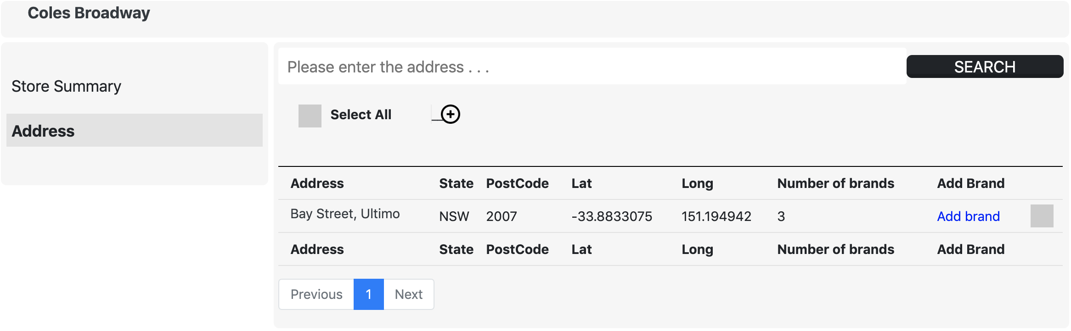
3
WEB-PAGE SERVER
Main Feature – Update & Delete Brand/Store (6/6)
1
2
DESCRIPTION
Admin can add more addresses into this store.
The “Add brand” button is clicked to add more brands into this store.

Slide 41
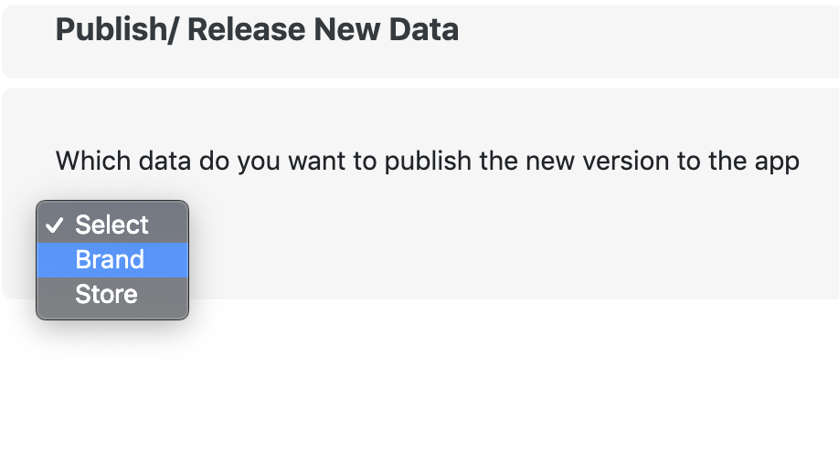
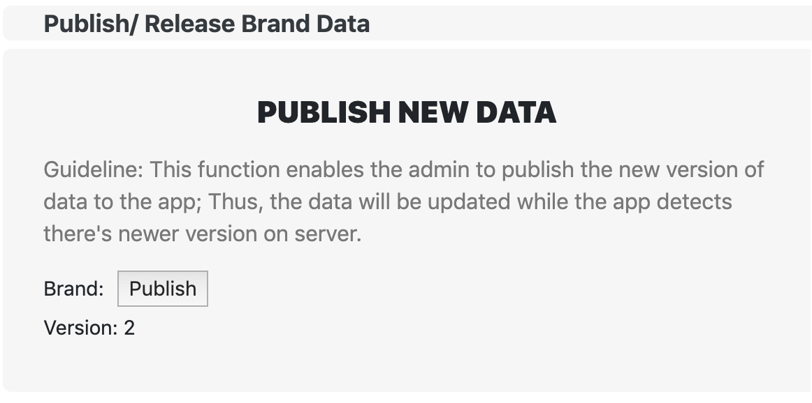
3
WEB-PAGE SERVER
Main Feature – Publish
DESCRIPTION
Admin can select brand or store to publish the new version of database.
The “Publish” button is clicked to make the version plus one.
The ”Version” shows the current version of brand or store database.
1
2
3

Slide 42
3
WEB-PAGE SERVER
Some Other Features
Reset the Admin account
Forgot password

Slide 43
TABLE OF CONTENT
1. | PROJECT BACKGROUND
2. | MOBILE APPLICATION
3. | WEB-PAGE SERVER
4. | LIMITATION & DISCUSSION
5. | CONCLUSION/ NEXT STEPS
6. | Appendix

Slide 44
4
LIMITATION & DISCUSSION
4 Main Limitations
Due to the time constraint of this project, there are still Limitations required to be improved.
Only for Android Operating System
Update User Profile after Sign Up
Import CSV File for store data
Unreliable Sourcing Data

Slide 45
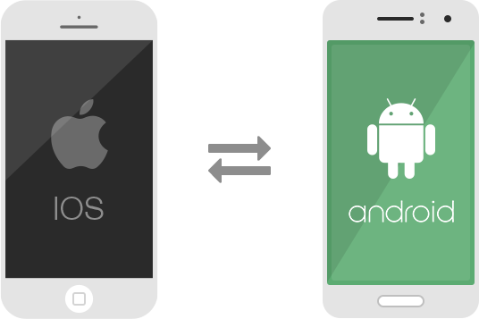
4
LIMITATION & DISCUSSION
Limitation – Only for Android Operating System
Our app COULD NOT reach to IOS users and collect data from them.
Future – Need to implement the app in iOS system.

Slide 46

4
LIMITATION & DISCUSSION
Limitation – Update User Profile after Sign Up
The app CANNOT allow users to modify their profile after registration.
Future - Enhancing user experiences.
Modify the Age
Make Account Email Confirmation
Modify the Birthday

Slide 47
4
LIMITATION & DISCUSSION
Limitation – Import CSV file for store data
In the Server-side, the Admin CANNOT import multiple store data at a time to the database. Although developing this feature was considered, the complexity of this function discourages the team from completing it.
Future – Implementing the “Import CSV file” feature for stores in the Server.

Slide 48
4
LIMITATION & DISCUSSION
Limitation – Unreliable Sourcing Data
The reported store data from app users MIGHT NOT be reliable and now only the Admin can justify whether the data is reliable or not.
Future – Adding the counts for reported store data from app users.
For Example, an app user reports a brand called “Adelaide eggs” which could be purchased in Coles Burwood and the Admin agrees with this data. The system will record this report with a “count” of one. Then the mobile app’s interface should be modified to display the total “count” of each piece of data.

Slide 49
TABLE OF CONTENT
1. | PROJECT BACKGROUND
2. | MOBILE APPLICATION
3. | WEB-PAGE SERVER
4. | LIMITATION & DISCUSSION
5. | CONCLUSION/ NEXT STEPS
6. | Appendix

Slide 50
5
CONCLUSION / NEXT STEP
Deliverables of the project: Mobile application and Web-page server.
By providing an information channel about animal-welfare the project helps close the consumers’ intention and behaviour gap.
Assist the client in collecting statistics for further research.
Next step:
The client will deploy the system with the manual and source code.
The project team will assist and resolve issues if any.

Slide 51
TABLE OF CONTENT
1. | PROJECT BACKGROUND
2. | MOBILE APPLICATION
3. | WEB-PAGE SERVER
4. | LIMITATION & DISCUSSION
5. | CONCLUSION/ NEXT STEPS
6. | Appendix

Slide 52
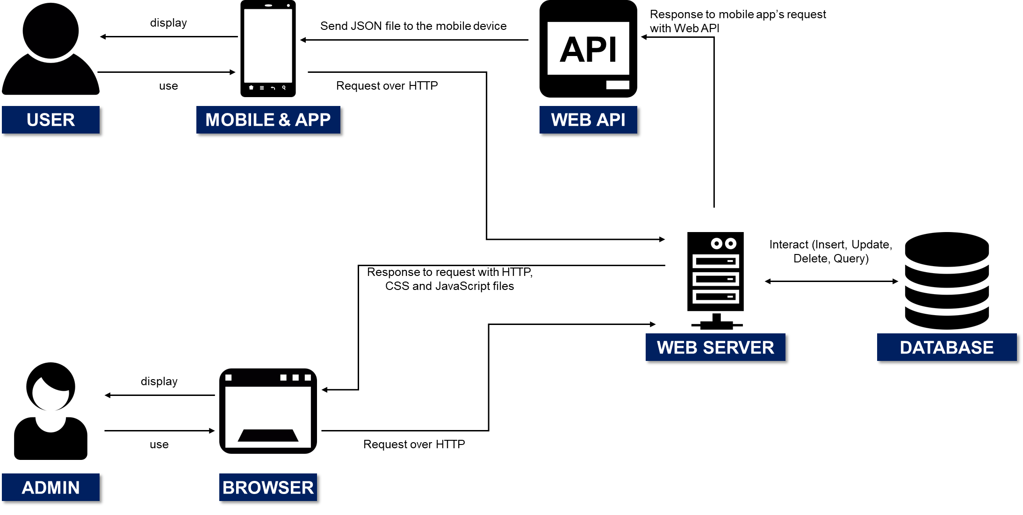
6
Appendix
Kinder Food Finder System Architecture
Kinder Food Finder system consists of two important parts: (1) Mobile application and (2) Web-page server
Figure 1. Architecture of the system

Slide 53
Thank You
ANY QUESTIONS?

